Slide 1
From Ripples to Waves DNS Reflection and Amplification Attack
University of Pavia, Italy

Slide 2
TABLE OF CONTENTS.
01
02
03
04
05
06
DDoS attack types and reasons behind the chosen method.
We will talk about this second.
Then, we will talk about this.
After that we will talk about this.
We will also talk about this.
And we will talk about this last.

Slide 3
DDoS Attack Types
01
<p> Distributed Denial of Service (DDoS) is a cyber attack aimed at running out of service a given target. </p>
Notes:
As you have seen from the first slide, our project is about the implmenetation of a DDoS attack, specifically a DNS reflection and amplification attack.
The choice was not made at random, instead it was the result of a selection and research process.
In the next slides i'm gonna introduce you to the reasons behind our choice and we are gonna see briefly some kinds of DDoS attacks.

Slide 4
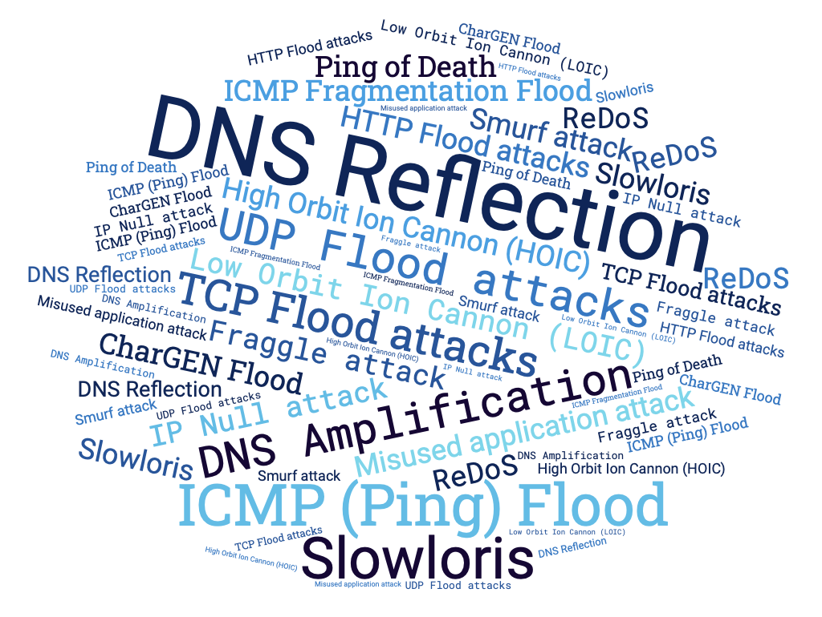
THERE IS PLENTY OF DDOS ATTACK TYPES
Our interest was in experimenting with a commonly employed approach in real-world scenarios, as opposed to sporadic cases.
Notes:
We started from the intention of simulating a DDoS attack, however as you can see from the figure, there many different ways in which this type of attack can be performed.
Our goal was that of experimenting something commonly used in real word situations and not just in sporadic cases.

Slide 5
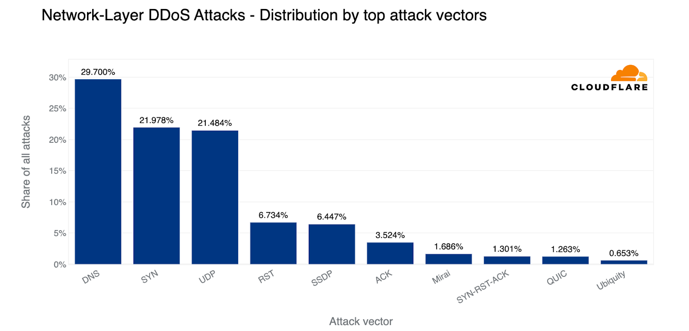
DID YOU KNOW?
<p> 1/3 of all DDoS attacks are DNS-based. <p>
DDoS involving DNS:
DNS Query Flood
TCP Flood
DNS Reflection and Amplification
Notes:
We discovered that according to a recent report by cloudflare, published in the first quarter of 2023, almost 1/3 of all the DDoS attacks are DNS based.
However also inside the sub-category of the dns-based attack there are several possibilites and here are listed the three most important.
DNS query flood, TCP flood and DNS reflection and amplification.

Slide 6
DNS Query Flood
Specifics
Goal: Exhausting target’s resources
How: Sending DNS queries directly to target (botnet)
Target: Recursive server or Authoritative server
Trick: DNS queries not already cached
Notes:
The DNS query flood is aimed at exahusting the target resources, by sending a huge amount of DNS queries.
The key point is sending lots of queries and this is achieved by the attackers using a botnet. A botnet is an army of compormised devices controlled by the attacker to send DNS queries.
This attack can mainly have two target, a recursive NS or an authoritative one.
In the case the target is the first one, there is a trick played by the attacker, that consists in crafting the queries in a such a way that they are not already cached in the server. That way the server is forced to query other NS until, eventually it gets the response and sends it back to the client.

Slide 7
DNS Water Torture
Specifics
Goal: Exhausting authoritative target’s resources
How: Sending a huge amount of queries
Trick: Creating FQDN as ‘[random host] + [target domain]’
Notes:
If the target is a specific authoritative NS, the attack takes the name of water torture.
The goal is the same as before, but on this case the trick played is that of crafting queries taking the domain of the target and adding a random string.
That way, we are sure the queries reach the target using its resources to answer to them NXDOMAIN.

Slide 8
TCP Flood
Specifics
Goal: Exhausting target’s resources
How: Opening lots of TCP connections
Trick: Do not close TCP connections
Notes:
TCP flood attack has still the goal of exhausting the target resources but instead of using UDP traffic it exploits the THREE-WAY handshaking of TCP.
The trick is to open a large number of TCP connections without closing them, therefore forcing the target to use its resources to handle it, until they are exhausted.

Slide 9
DNS Reflection and Amplification
Specifics
Goal: Exhausting target’s bandwidth
How: Reflecting and Amplifying queries on DNS recursive NS
Trick: Spoofing IP (not difficult with UDP protocol) + ANY
It is the Most used DNS-based DDoS attack
Notes:
The last type of attack is the DNS reflection and amplification.
The goal of this attack is to exhaust the target network bandwidth by exploiting the concepts of reflection and amplification.
It starts with the spoofing of the IP address of a victim by the attacker. Then the attacker sends lots of queries to a misconfigured DNS recursive server that will consequently respond to the victim IP.
So we have a kind of reflection on the name server.
The amplification affect is obtained since usually the types of queries performed are of type ANY, therefore the response size is larger than the query, leading to an amplification effect.
The higher the amplification factor, the higher the impact of this attack.
According to the already cited report, DNS reflection is the most commonly used attack among the dns-based ddos, so we decided to simulate it.

Slide 10
Experimental SETUP
02
<p> To ensure the success of the project, it is essential to establish a clear methodology</p>
Notes:
To ensure the success of the project, it is essential to establish a clear methodology that consists in a systematic approach that allows for the accurate replication of a DDoS attack while maintaining ethical considerations and minimizing the potential impact on public network.

Slide 11
Why
Which/Who
Identify DNS vulnerabilities
Evaluate Network resiliance
identify potential countermeasures
1 laptop hosts DNS server
4 laptops perform the attack
1 laptop act as victim of spoofing
Notes:
The objective is to asses Dos attck by expoiting the DNS protocol and monitoring the reachability of the targeted device and the nodes available on the network. Our study aims to identify the vulnerabilities within the DNS protocol, evaluate the network resiliance and finally identify potential countermeasures that could be applied to limit the impact of the attack.
In the simulation 6 laptops has been used:
1 hosts the dns server
4 perform the attack
1 is the victim of spoofing, since the attackers does not send dns queries using their actual ip, but they use the ip of the spoofed laptop

Slide 12
What
Where
RTT before and during the attack
Response time of DNS query
Resources used by the DNS server
1 laptop monitors the status of the network
LAN isolated from internet
Notes:
The choosen metrics encompass the the evaluation of the rtts of icmp packets and response time of the dns queries, considering also possible timeouts. In addition, the resources allocate by the server were monitored ,
All these measurments wer taken before and during the attack.
For what concerns the vantage point of the monitoring phase, one laptop were dedicated for this task.
And the experiment were conducted inside a Local Area Network which were isolated form internet in order to avoid that the attack could impact the public network devices.

Slide 13
Tools used
03
Notes:
In our experimental setup, we utilized a set of essential tools.

Slide 14
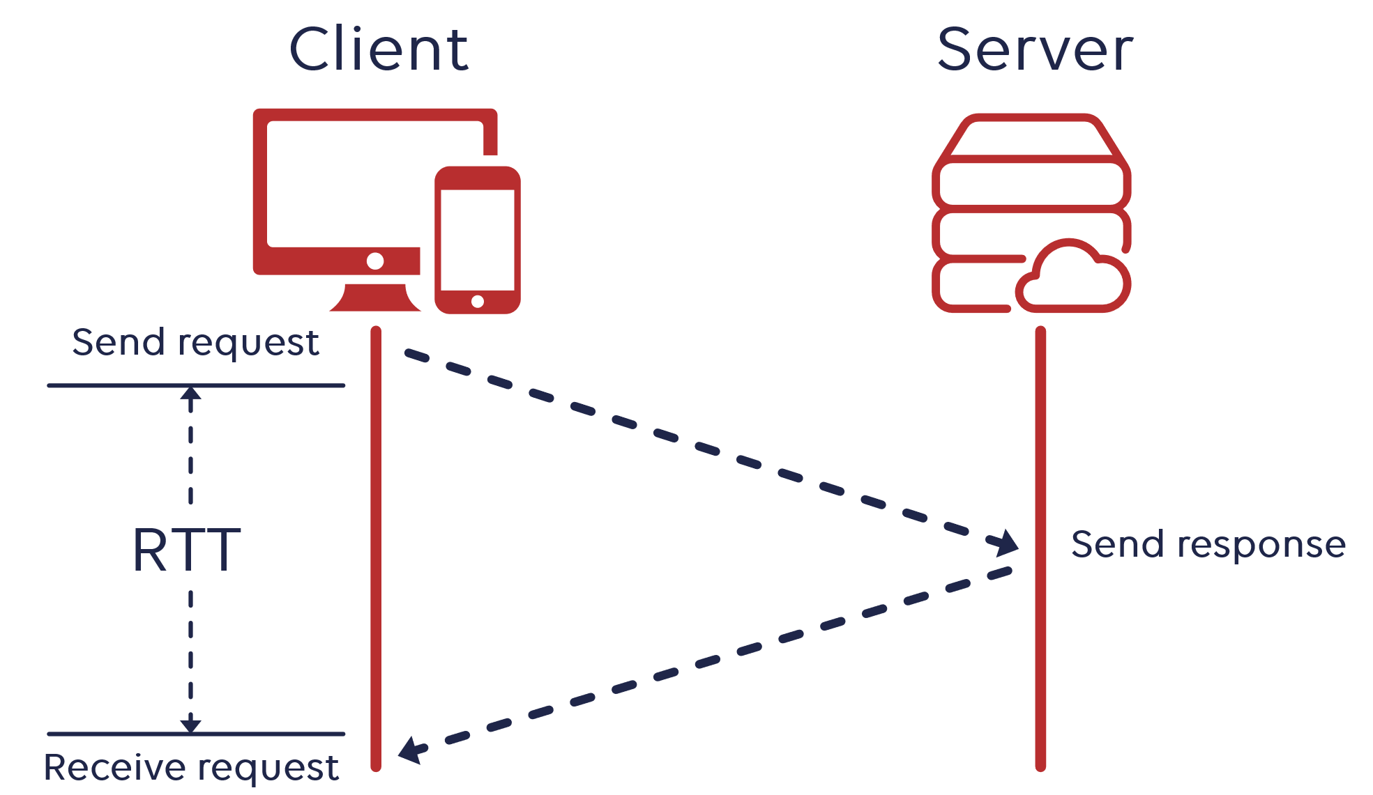
PING
Network utility tool
Sends small packets to a specific IP address
Measures the RTT
Notes:
The first tool we employed is Ping, a network utility tool used to test the connectivity between two networked devices. It essentially works by sending a sequence of icmp packets and measures the Round trip time, which is the time to send, receive and return.

Slide 15
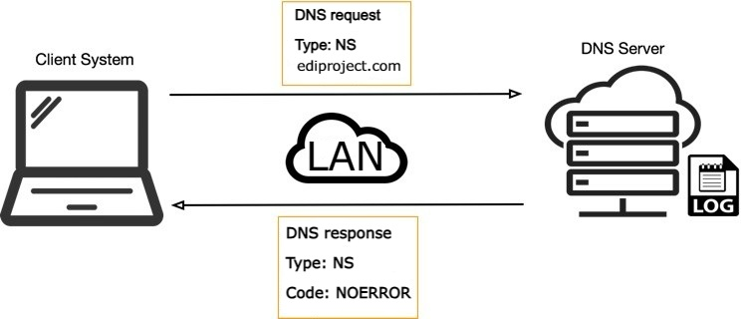
DIG
Domain Information Groper
Performs DNS queries
Measure query time
Used to check DNS records and the status of the server
Notes:
Another tool is DIG which stands for Domain Information Groper.
It allows users to perform DNS lookups to check DNS records and obtain information about DNS configurations. It were used to measure the response time of dns queries and also in the preliminary phase, to check if the dns server were reachable and properly configured.

Slide 16
TOP
Tool used to monitor the system resources, like memory and CPU usage.
Used to monitor the resources allocate by the server before and during the attack.
Notes:
a command that provides real-time monitoring of system resources such as CPU usage, memory utilization, running processes, and more. It displays an interactive, dynamic table that continually updates, enabling users to view the current state of their system.

Slide 17

Wireshark
Open-source network protocol analyser
Designed to capture, analyse, and display network traffic in real-time
Used to monitor the status of the attack, in terms of number of packets sent, and the behaviour of the DNS server
Notes:
an open-source network protocol analyser. Wireshark is designed to capture, analyse, and display network traffic in real-time. It were used to monitor the traffic of the network under attack

Slide 18
DNS server configuration
04
Notes:
Let’s go deeper in the dns server configuration

Slide 19
The configuration
Running on Ubuntu 20.4 LTS
BIND9 implementation
Authoritative server for the domain “ediproject.com”
No security measures. The devices on the LAN were able perform all queries
Notes:
The server were running on Ubuntu 20.4 OS.
BIND9 is the selected implementation of the DNS server, because it is open source.
And it can be easily customized by editing the configuration files.
The Server were configured as a local DNS with autority over the domain ‘ediproject.com’
We decided to not implement any security measure in order to facilitate the attack and make it more effective.
So all devices on the LAN were able to perform any kind of request

Slide 20
Resurce Records
1 record of type SOA
6 records of type NS
5 records of type MX
10 records of type A
Notes:
Since we would perform the attack using different amplification factors, the server was configured to have different number of records for each type. By doing that the amplification factor can be changed only by modifiyng the type of records in the queries sent by the attacckers.

Slide 21
Mechanisms for MITIGATION
06
<p> DNS is vital for the Internet, so protecting it from DDoS and any other type of attack is crucial. </p>
Notes:
The DNS is vital for the internet, so protecting it from DDoS and any other type of attack is crucial.
To achieve this many mitigations measures have been deployed across the years and we are gonna see some of them in this section.

Slide 22
Proactive measures
Reactive measures
Rate Limiting
Trusted Sources
Firewall
Machine Learning
Anycast Scheme
Caching Behavior
Notes:
They can be roughly classified in two categories.
Proactive measures that tries to prevent and avoid the attack.
Reactive measures aimed at identifying and stop as soon as possible the attack, while increasing the system resilience as well.
Read the measures.

Slide 23
Proactive measures
Rate Limiting
Trusted Sources
Firewall
Trusted whitelist
Reduce available IP to spoof
Risk trusted IP to be spoofed
Limit N. responses to same I
Reducing reflection effect
Traffic control
Traffic filtering
Notes:
The idea behind the rate limiting is to limit th enumber of response a server can provide to a given IP. That way the server can stop providing answer to the spoofed IP and the reflection effect is mitigated.
As regard the trusted sources the idea is to create a whitelist of IP that are legitimated to send queries to the DNS server.
Thereby, the number of IP that can be spoofed to perform attack is reduced and consequentely the probability of an attack.
However there is still the risk of the trusted IP to be spoofed, so it is not a foolproof measure.
Lastly it is possible to set firewall to control and filter traffic to block the queries and prevent the attack.

Slide 24
Reactive measures
Anycast Scheme
Machine Learning
Caching Behavior
Server replication
Traffic distribution (routing)
Hard to push all servers down
Classification algorithms (SVM, Neural Networks, Trees)
Vulnerable to adversarial approach (EAD)
No TTL expired eviction if unavailability
Cached query served even during attack
Notes:
Here are some reactive measures.
The first is the anycast scheme. The idea here is to create replicas of the server all with the same logical IP and use the anycast scheme to choose at any time the best server according to some criteria (like availability and traffic).
Thereby, the attacker would have to run out of service all the server which becomes more diffucult the higher the number of servers.
With machine learning the idea is to train some classification algorithms like SVM, NN and trees (random forests) to discriminate between an attack situation and a legitimate one, according to some features extracted from the queries.
However has been recently shown that using an adversarial approach the classification algorithm can be fooled.
This apporach conists in taking a two netowrk, the classifier and another challenging it. This network can learn to slightly change the features to fool the classifier.
The idea of cahching behavior is to keep providing the cached entry when a relevant server is down, indipentely on the TTL. That way even during an attack the cached entries can be served, increasing the resilience of the system.

